Slide 1
Evaluating success of the team
Jeff Leek
@jtleek
www.jtleek.com

Slide 2
Group success
Solving organization problems
Solving internal problems
Metrics

Slide 3

https://hbr.org/2013/03/know-the-difference-between-yo/

Slide 4
Individual success
Completion of projects
Personal improvement

Slide 5

“
An ideal situation is when you’re studying on your own and maybe you have some type of mentor who you talk to now and then. You should be alert that you’re going to make some dumb mistakes at first. And some will take a one-time correction. Others will take a lifetime to learn.
”
-Nate Silver
Source: http://bit.ly/1OEvdk4
Image: http://bit.ly/1K0xy7Y

Slide 6
Examine failure
Take responsibility
Identify the problem
Concrete steps toward a solution

Slide 7
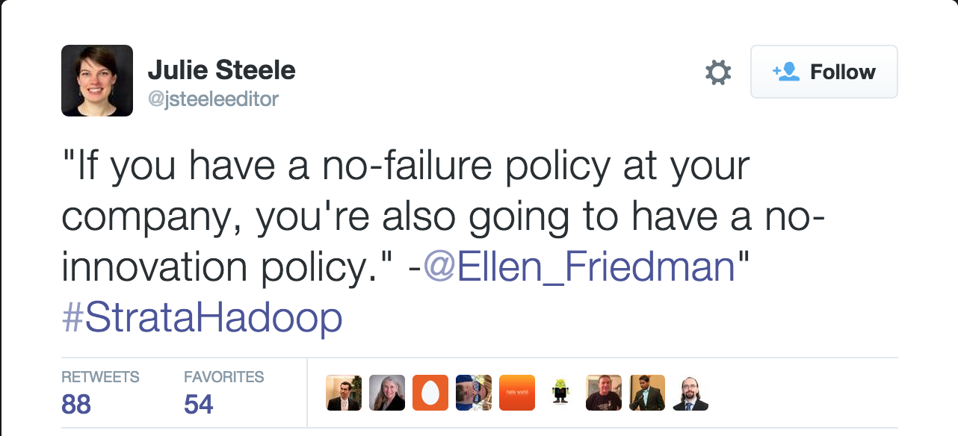
https://twitter.com/jsteeleeditor/status/595542015032463360

Slide 8
Celebrate success
Important to make your team known
Keeps people motivated

Slide 9

http://www.digitalistmag.com/human-resources/5-ways-to-celebrate-success-with-your-team-in-2015-01967947

